Slide 2
Disclaimer
Document Name:
Data Classification: INTERNAL
Disclaimer
The contents of this document are property of Softtek, and are classified as Confidential. Any reproduction in whole or in part is strictly prohibited without the written permission of Softtek.
This document is subject to change. Comments, corrections or questions should be directed to the author.
Audience/Viewership | Purpose
Revision Chart
The following chart list the revisions made to this document. Use this to describe the changes and additions each time this document is re-published. The description should be detailed as possible and include the names of the reviewers who request the changes.
Version No. | Version Date | Types of Changes | Owner/Author | Date of Review/Expiration

Slide 3
CD Pipeline from Tester’s perspective

Slide 4
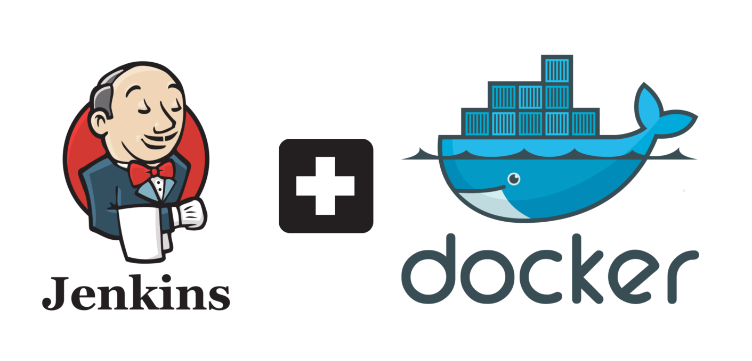
Jenkins and Docker
Jenkins is a self-contained, open source automation server which can be used to automate all sorts of tasks such as building, testing, and deploying software. Jenkins can be installed through native system packages, Docker, or even run standalone by any machine with the Java Runtime Environment installed.
Docker is the world’s leading software container platform. Developers use Docker to eliminate “works on my machine” problems when collaborating on code with co-workers.

Slide 5
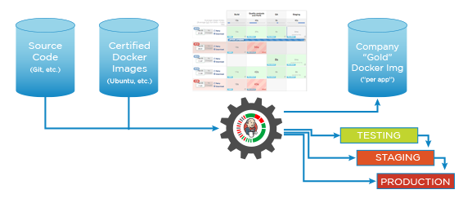
Jenkins and Docker
There is a transformation happening in IT and it is made up of three waves of innovation: infrastructure, application architectures and process/methodologies. Lightweight Docker containers, microservices-based application architectures and continuous delivery are simultaneously feeding on each other and giving IT the ability to provide more value faster to the business, consumer and user.

Slide 6
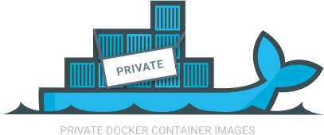
Private Registry
By default, your registry data is persisted as a docker volume on the host filesystem. Properly understanding volumes is essential if you want to stick with a local filesystem storage.
A data volume is a specially-designated directory within one or more containers that bypasses the Union File System.
Union file systems implement a union mount and operate by creating layers. Docker uses union file systems in conjunction with copy-on-write techniques to provide the building blocks for containers, making them very lightweight and fast.
union mounting is a way of combining multiple directories into one that appears to contain their combined contents.

Slide 7
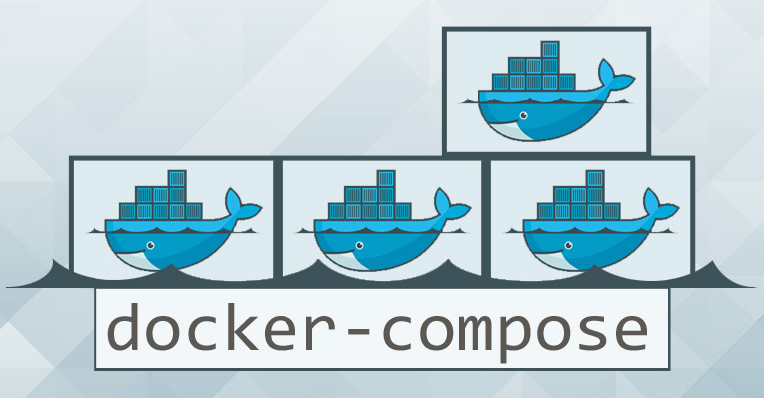
Docker Compose
Compose is a tool for defining and running multi-container Docker applications. With Compose, you use a Compose file to configure your application’s services. Then, using a single command, you create and start all the services from your configuration.

